Slide 1
UPDATE ON THE IMPLEMENTATION OF THE
MENTAL HEALTH STRATEGY
26TH SEP 2022
Notes:
The mental health strategy is the priority

Slide 2
The scale of the problem
Any mood/ anxiety disorder – 1 in 8 (12.6%).
Conduct problems – 1 in 10.
Hyperactivity – 1 in 7.
Disordered eating – 1 in 6 (16.2%).
Self-harm – 1 in 10 (9.4%).
Thought about/ attempted suicide – 1 in 8 (12.1%).
Adults
Probable mental illness 2019/2020; 19% (same as Eng).
(Jan-June 2021 = 25%; 30% Jan, 19% in June) (NISRA).

Slide 3
Counting the cost
Cost to UK £117 billion (5% of total GDP - UK Furlough scheme = £70 billion).
Cost to NI £3.4 BILLION annually.
Cost of our Mental Health Strategy = £1.2 BILLION over 10 years.
72% lost productivity & unpaid informal care.
56% 15-49yrs; 27% 50-69yrs.
Depression 23%, anxiety 18%, bipolar 17%, schizophrenia 8%.
Underestimate (excludes dementia, addiction/ substance use).

Slide 4
Implementation
Mental Health Strategy Delivery Unit (1 x DP and 1 x SO).
The model for the Regional Mental Health Service.
Mental Health Workforce Review.
Regional Outcomes Framework.
Continued investment in community perinatal mental health services.
The development of Early Intervention & Prevention plan.
Structured engagement and capacity building with C&V Sector.

Slide 5
Funding
A significant additional investment is required in mental health services in order to implement the Strategy.
The total estimated funding requirement is £1.2bn over 10 years.
An additional £2m was allocated to the MHS for continued implementation of the 22/23 priority actions.

Slide 6
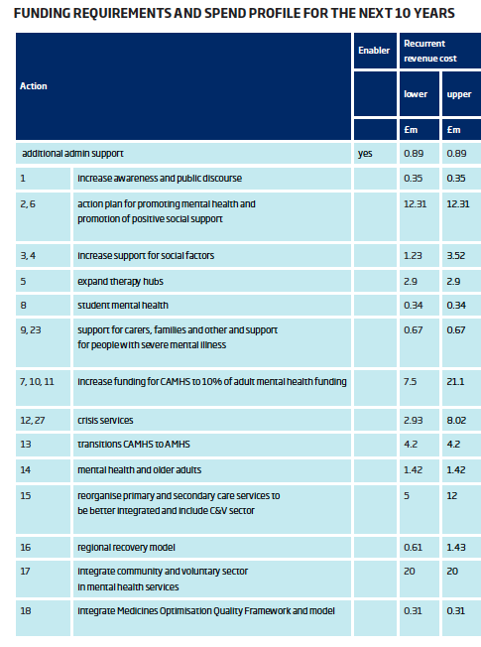
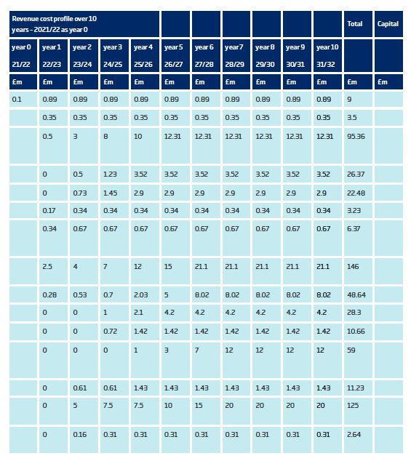

Slide 7
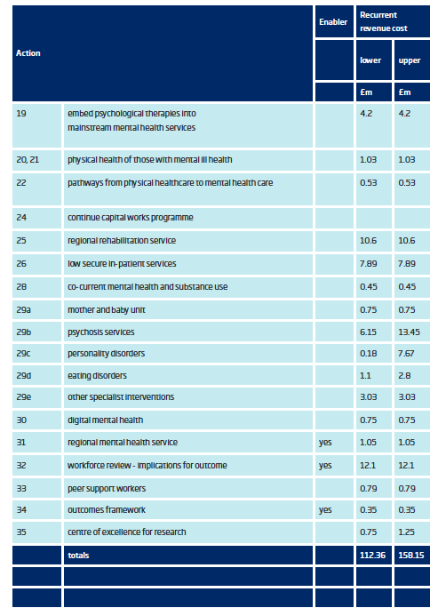
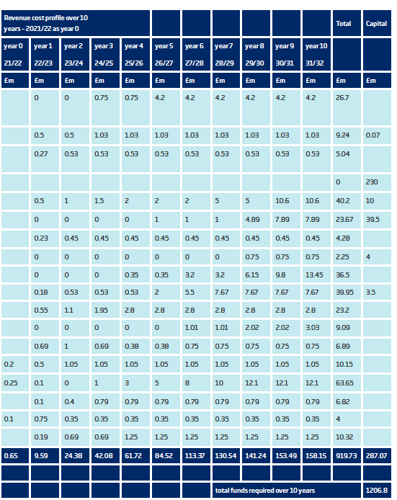

Slide 8
Years 0-5

Slide 9
Regional Crisis Service (Action 27)
HSCB and PHA are leading on the implementation of the new crisis service through the 10 actions in the policy, HSC Trusts responsible for the implementation and delivery of regionally consistent services.
The HSCB and PHA have developed an implementation plan in line with Action 10 of the policy (Nov 2021).

Slide 10
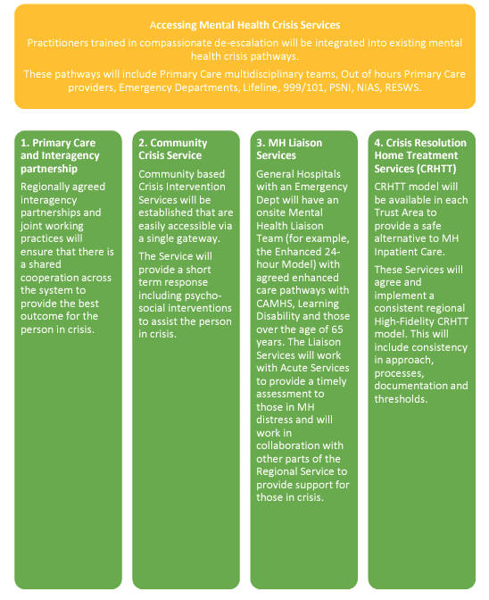

Slide 11
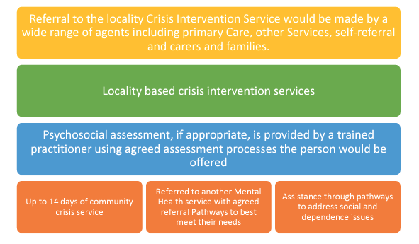

Slide 12
Other important initiatives
Protect Life 2
Framework for Schools
Preventing Harm, Empowering Recovery

Slide 13
Recession & suicide
England
2008-2010
1000 deaths
2008 economic crisis → inc. in suicides in countries without strong financial protections.
1000 additional deaths in England 2008-2010.
RoI: 476 more male & 85 more female deaths (5yrs) (male suicide rt 57% higher in 2012).
9000 additional hospital presentations for self-harm and attempted suicide.
Financial struggles, unemplopyment, loss of home & debt carry highest risk, esp for men.
NI 2006-2011, financial crises a contributory factor in 1 in 5 suicides in middle aged men.
Many of the deceased males not in contact with GP or MH services.
Impact of the crisis in NI worse than elsewhere (1 in 5 & >100,000 children in poverty)..
Food insecurity- 1 in 14 households. Over ¾ of the population in fuel poverty by Jan23.
30-40,000 attempts

Slide 14
Suicide Prevention - Autumn 2022
Mitigations to support the people who will suffer most in COL crisis.
Inc. Social Welfare payments, esp disabled & families.
Funding for interventions to reduce & treat the mental health impact.
Suicide prevention training for frontline workers providing advice & helping people manage the impact of economic crisis (e.g. financial service providers, Social Welfare agencies, foodbanks.
MH services/staff need to be able to direct people to sources of financial support & support to manage financial pressure.
Support for people to avoid debt & manage problem debt.
Resources for agencies who support people in managing problem debt so that they can meet the demand.

Slide 15
NICCY Still Waiting Monitoring Report (Feb 2022)
Incomplete actions embedded into other longer-term strategic plans.
Need for improvement in range of data collected, used by system and available in the public domain that covers service activity, mental wellbeing and outcomes.
Strengthening engagement mechanisms between those developing mental health policy, children and young people and other key stakeholders.
Advancement in data, engagement with CYP in planning and delivering of strategic plans are big enablers.

Slide 16
Current Issues
Waiting times too long, numbers waiting remains high.
24% increase in referrals from ED (frm 10/20-20/21).
GPs and EDs unsuitable – crisis services (& schools).
No clear evidence of improvement in support & outcomes for children with additional needs.
Strengthen role of regulatory body.
Expanding ETI’s inspection role of schools to include pupil wellbeing.
Implementation of NICE guidelines for medication (self-harm/ suicide).
Detailed mapping exercise for CAMHS funding plan.
Emotional wellbeing teams in schools (in progress).
Pilot PS counselling (workforce, delays).

